Slide 1
Order Book System (Challenge-2)
Team-57

Slide 2
Problem Statement
The problem statement is focused on building a workable Order-Book Management System.
The term Order-Book refers to an electronic list of buy and sell orders for a specific financial instrument like stocks.

Slide 3
Introduction
Customers can place new order for stocks purchasing when market is open and Admin can execute the orders when market is closed.
The market open/close action will be handled by Admin. Once market is closed, no new orders can be placed by Customers
When the market is closed , Admin has to ‘execute’ the orders.
The system focus on only Buying the financial instrument .

Slide 4
Modules
Admin Module
Admin can OPEN/CLOSE the Market.
System should not accept any order when ADMIN close the market.
When ADMIN Close the Market, Orders can be processed. Admin can select the stock and see all the orders for the day.
Every Executions of order will accept 2 inputs – Execution Qty and Execution Price.
If Execution is added , some orders become REJECTED – if order is LIMIT order and its order price is lower than Execution price. All subsequent Execution will have same execution price. Execution price cant change
The Execution Quantity should be distributed linearly among all accepted order . ACCEPTED Order i.e. all market orders and where LIMIT Order price is greater or equal than Processing Price
System should accept execution till all ACCEPTED Orders gets processed for specific Stock.

Slide 5
Modules
User module
Customer can place new order for any stock when market is open.
Customer need to select the stock and then select the order type which is either “Limit” or “Market”.
If the selected order type is Limit then the price limit of the customers is to be entered.
And finally the quantity of the stock to be purchased is entered and order is placed.

Slide 6
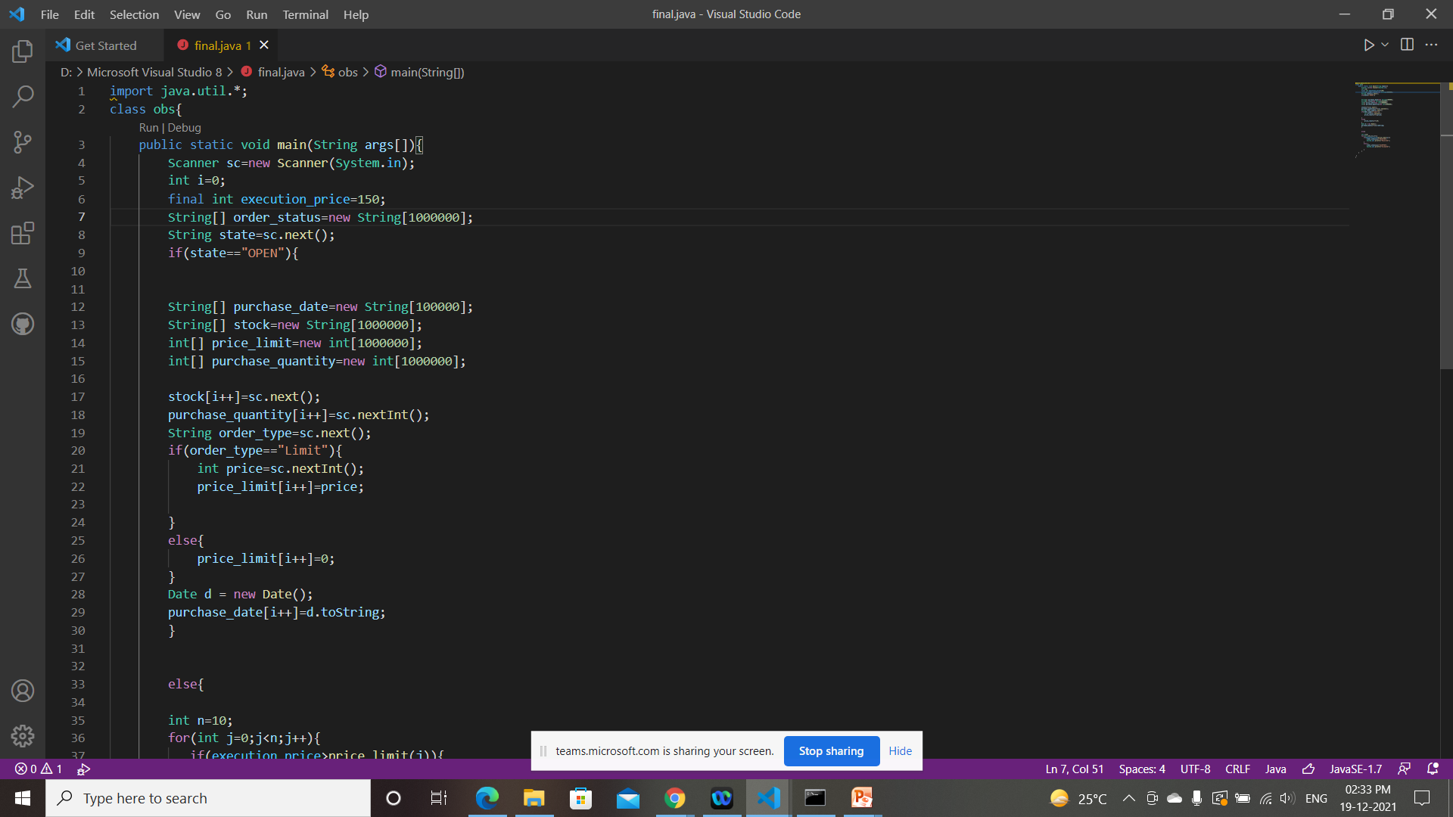
Implementation

Slide 7
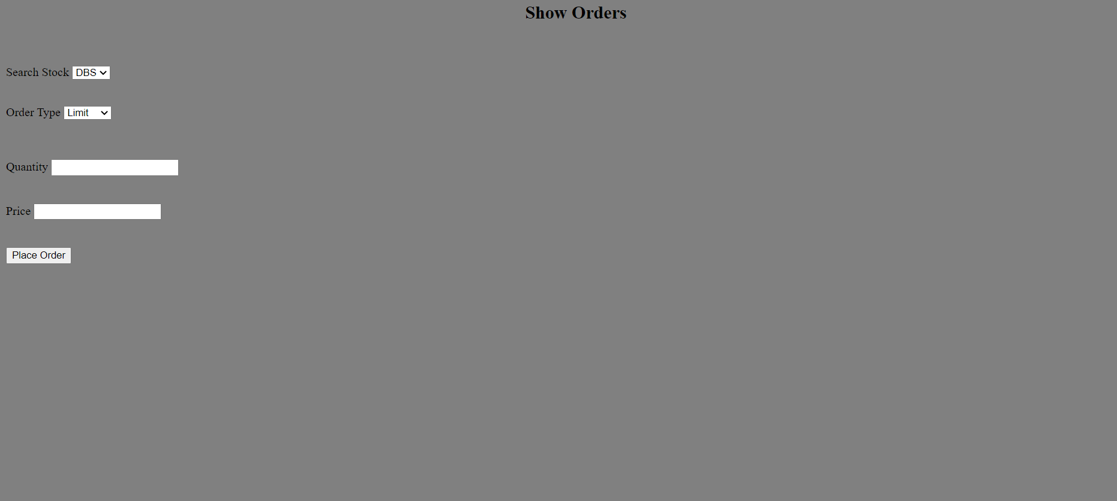
Implementation

Slide 8
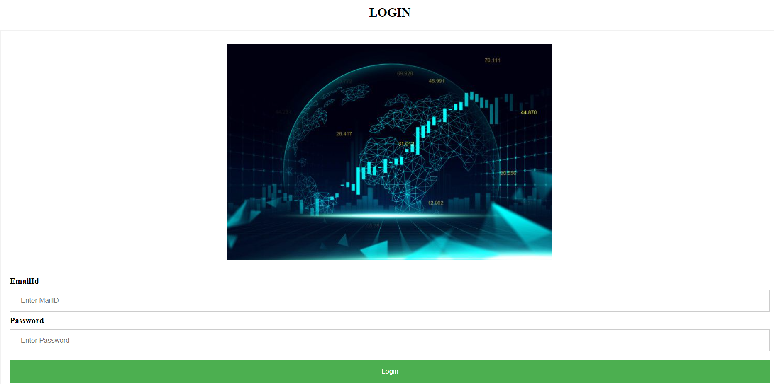
Implementation

Slide 9

Implementation

Slide 10
Q & A

